Slide 1

Locally weighted Regression K- Nearest Neighbour

Slide 2
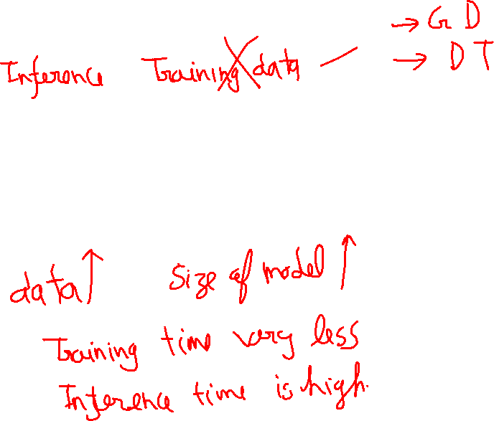
Parametric Learning Algorithm
Non Parametric Learning Algorithm

Slide 3

Recap Linear regression

Slide 4
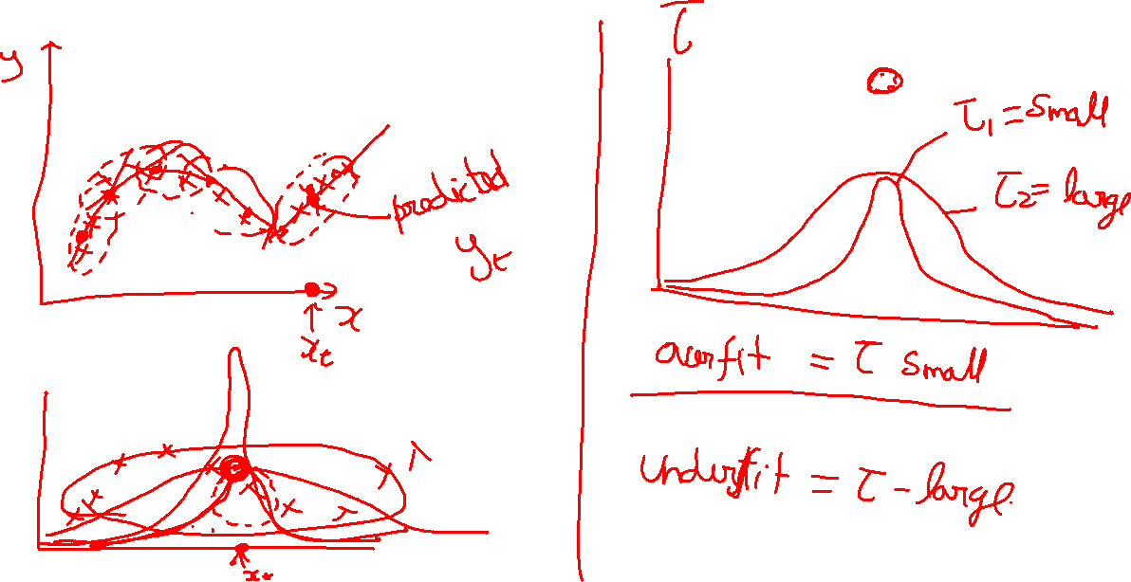
Locally weighted regression

Slide 5
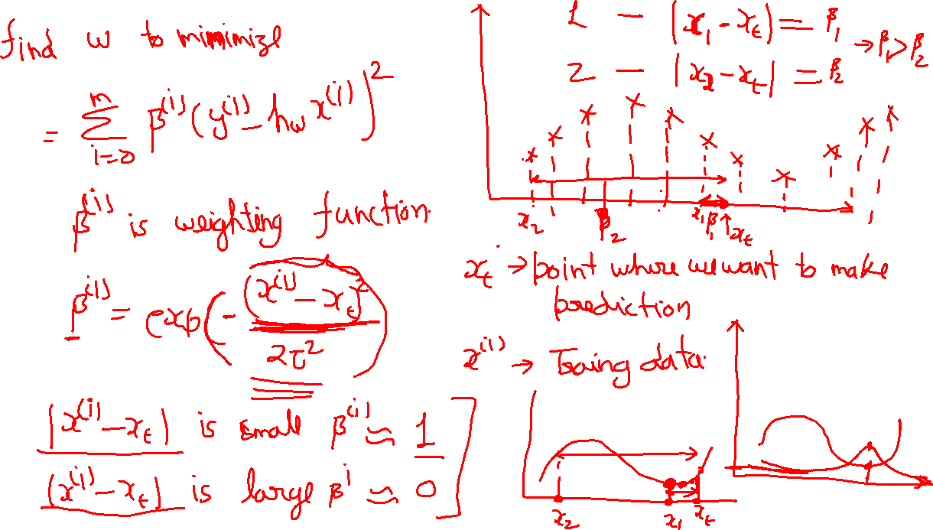

Slide 6
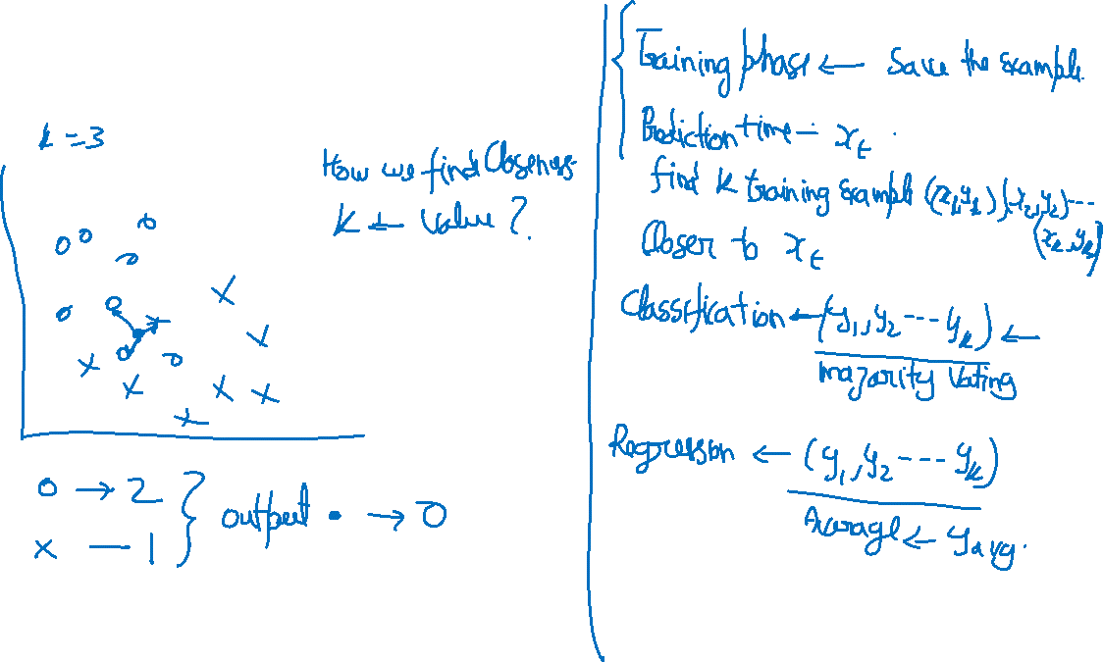
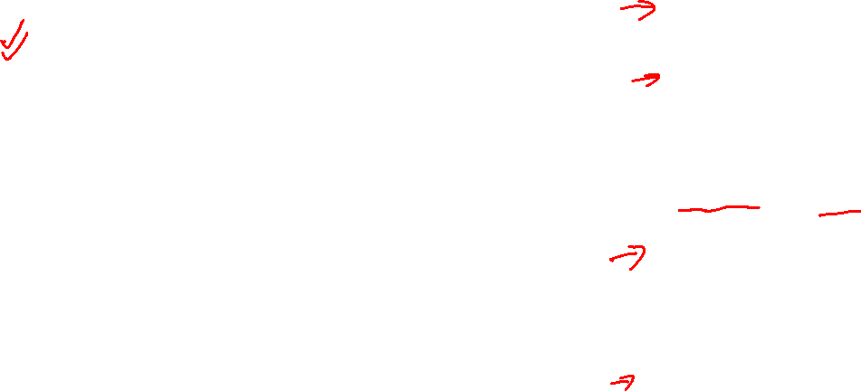
K- Nearest Neighbour

Slide 7
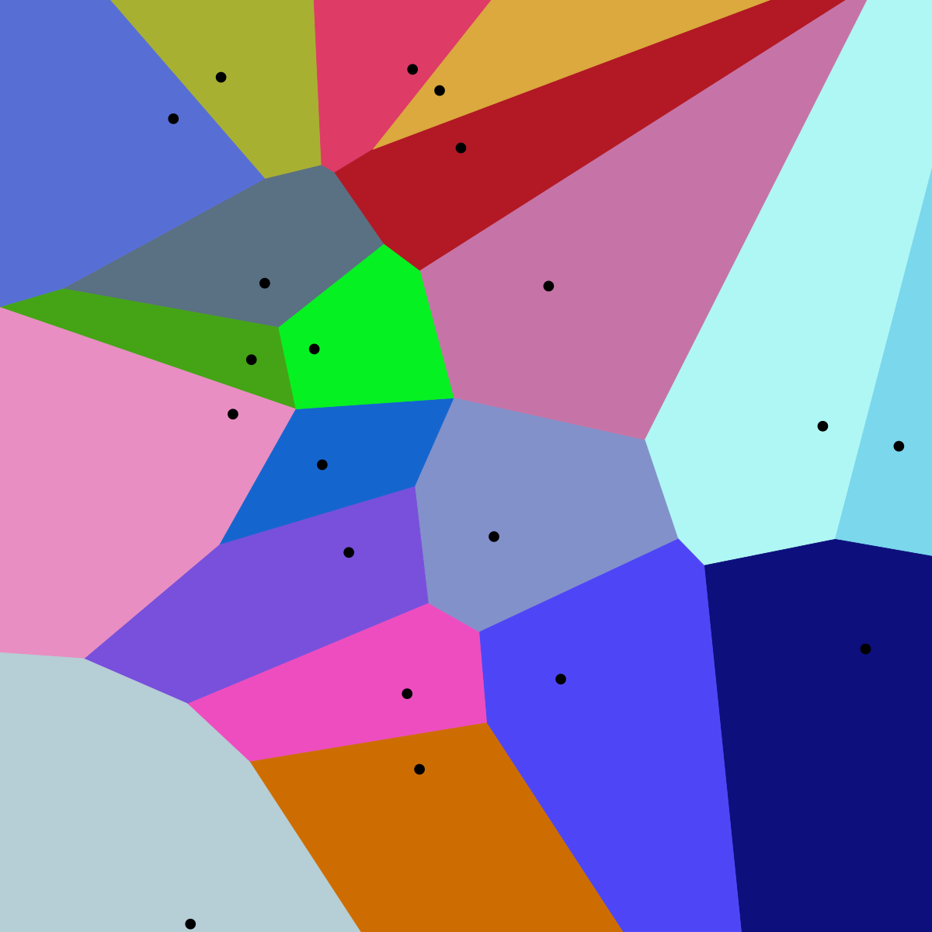
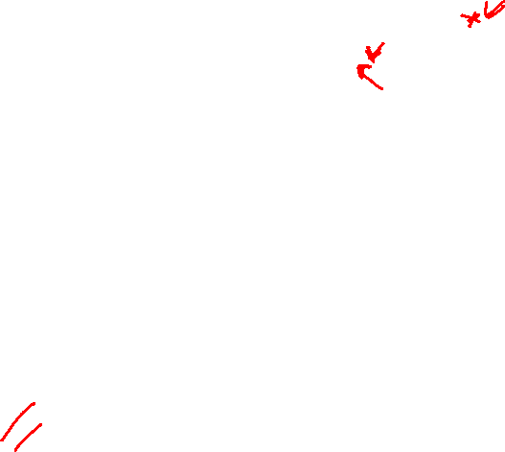
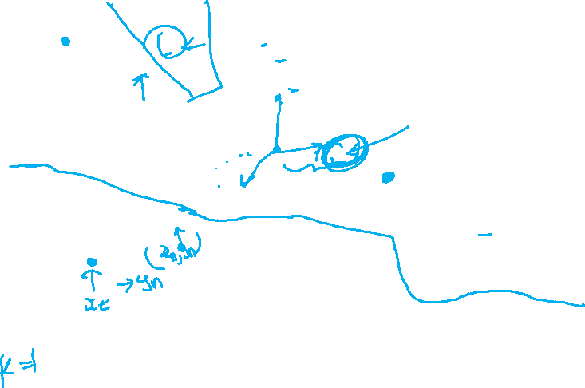
Voronoi diagram

Slide 8
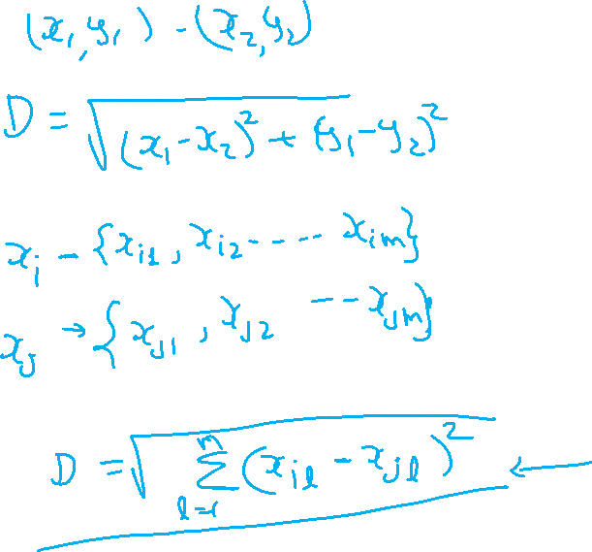

Distance

Slide 9
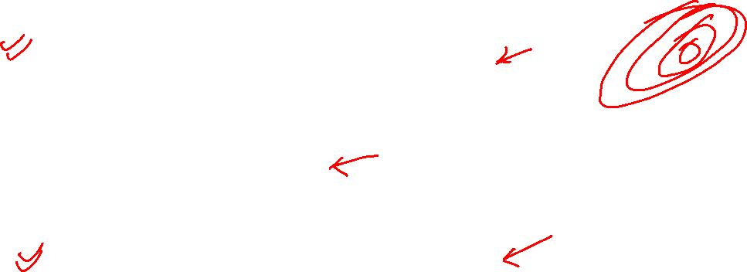
Assumption in traditional K-NN
Giving equal weight to all attributes
Scale of attribute range are same
Equal variance
Classes are spherical
Attributes have very less Noise
All attribute have same importance

Slide 10

How to overcome this
Use large K value
Weighted distance function

Slide 11
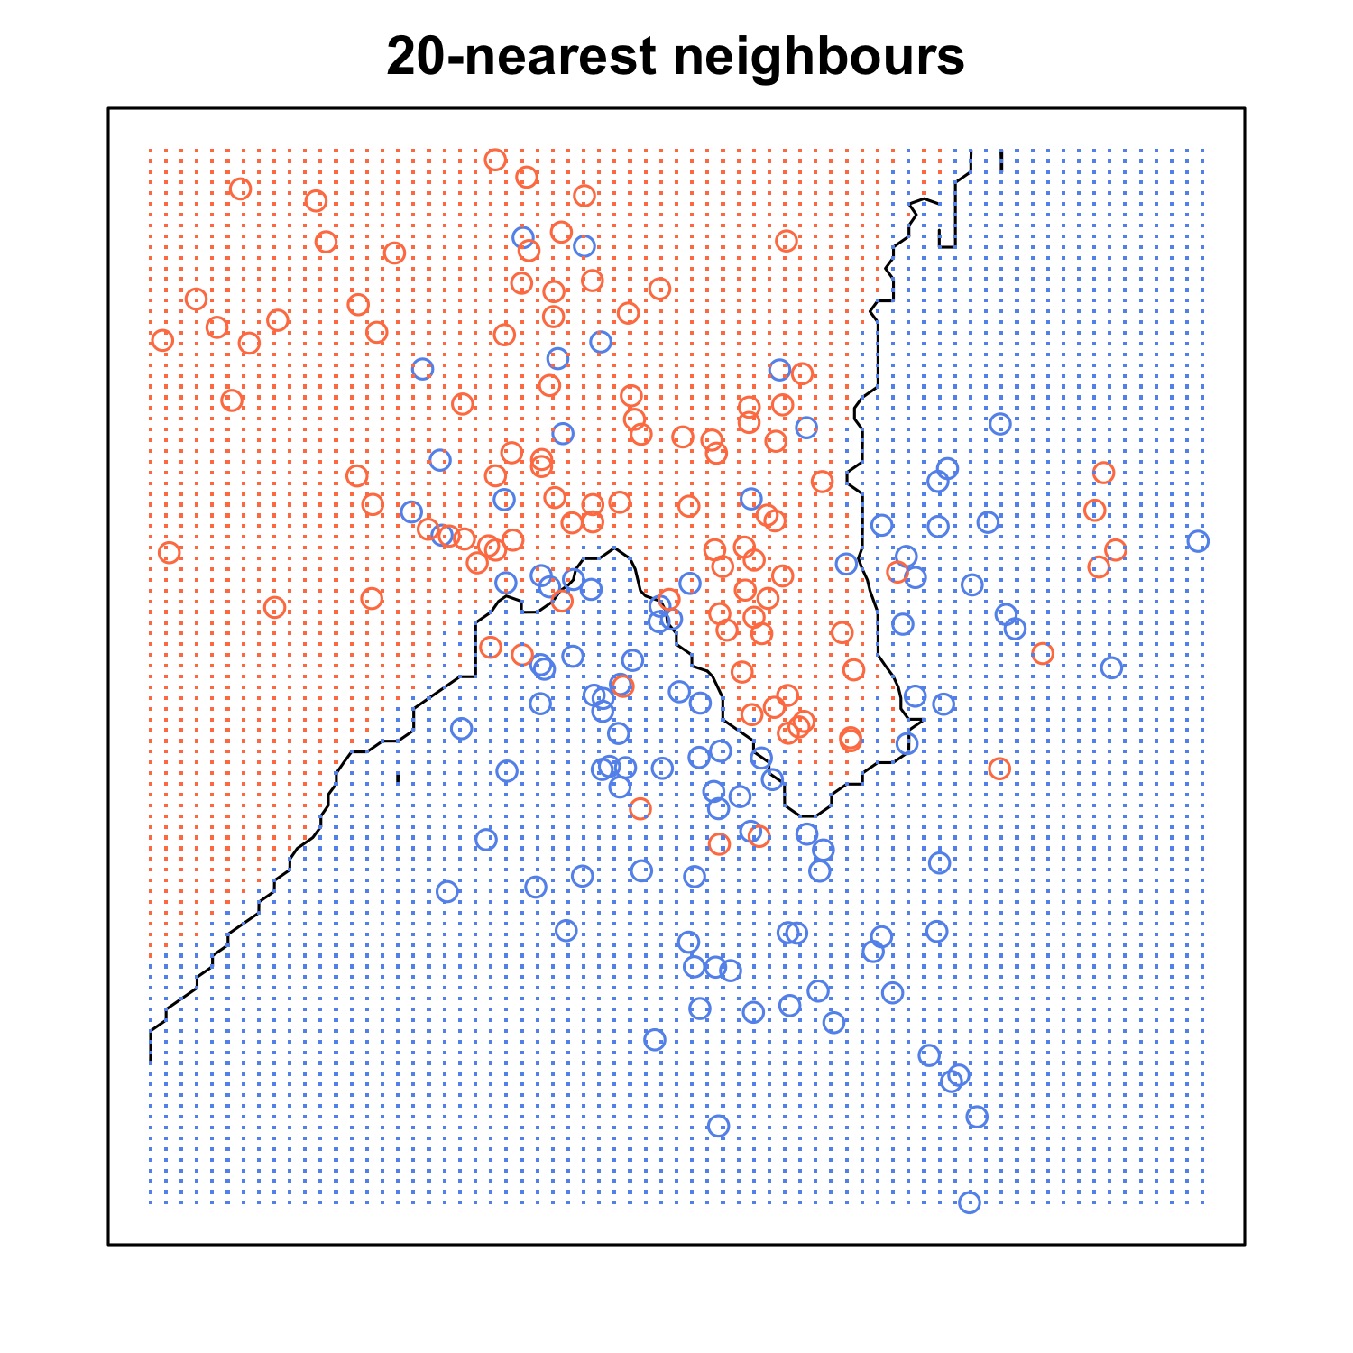
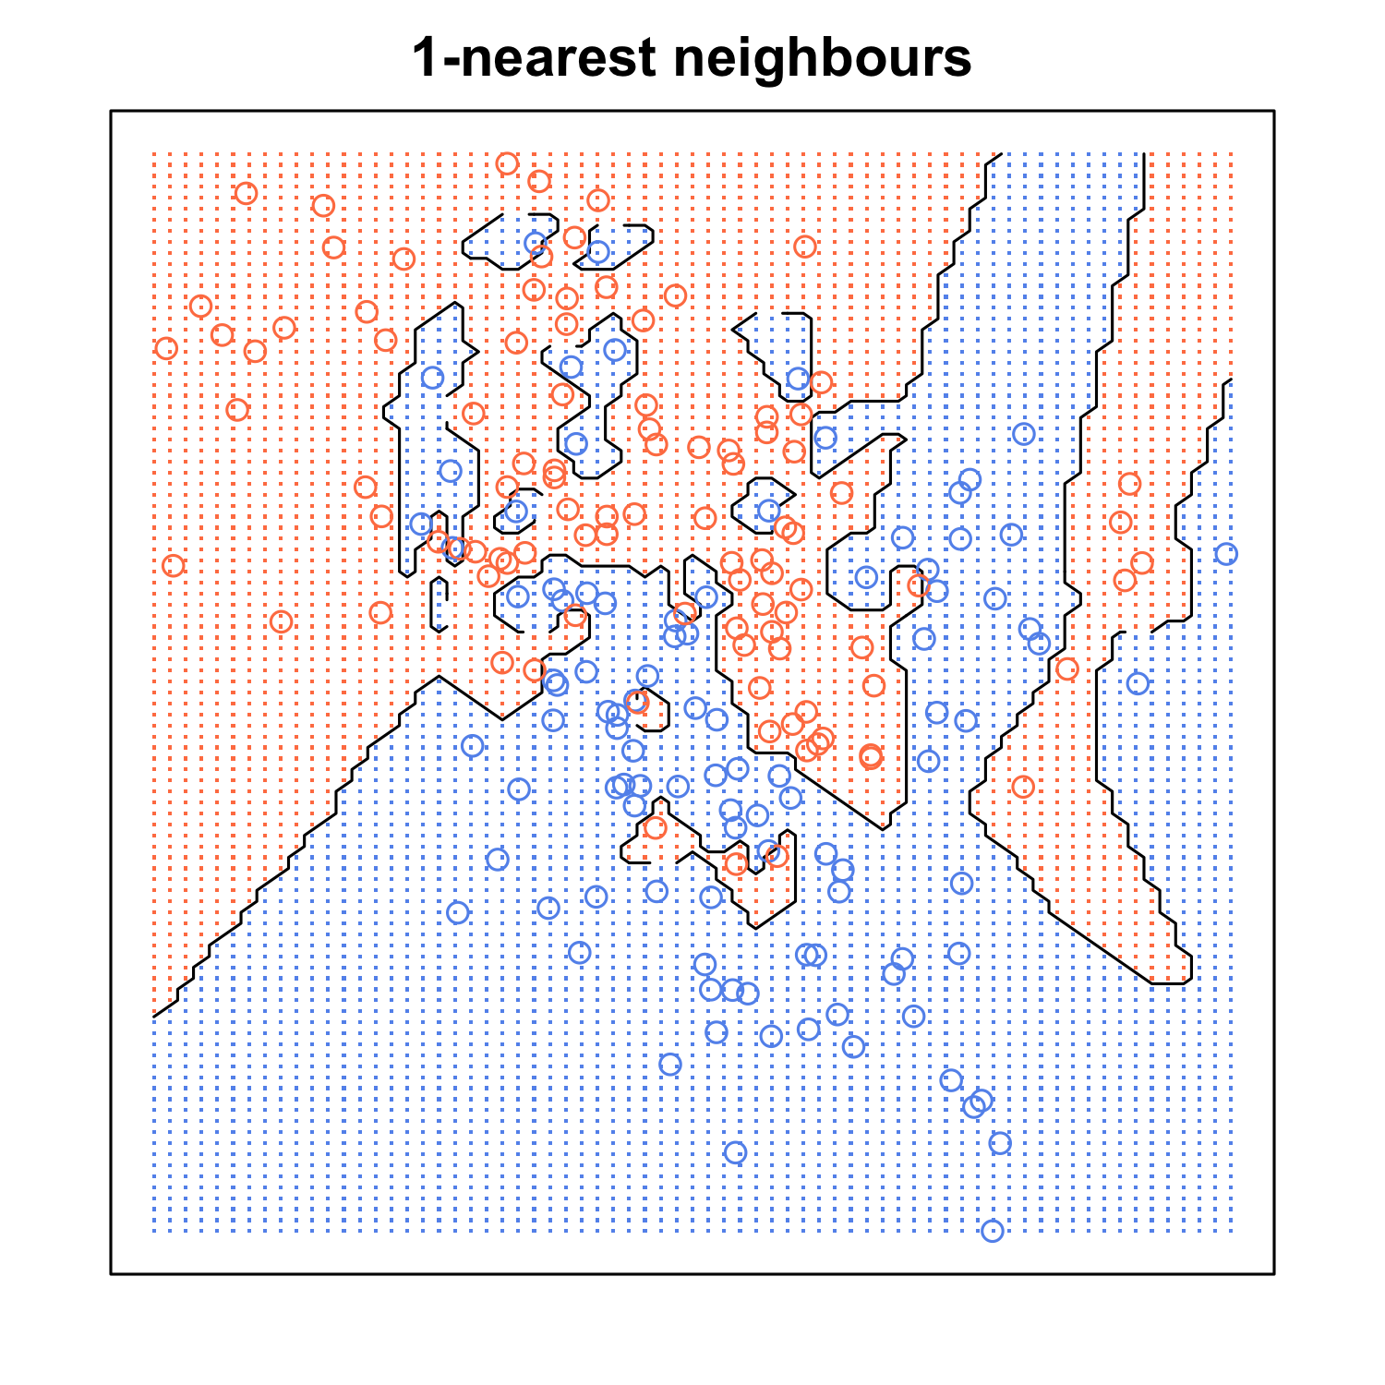



Impact of K

Slide 12
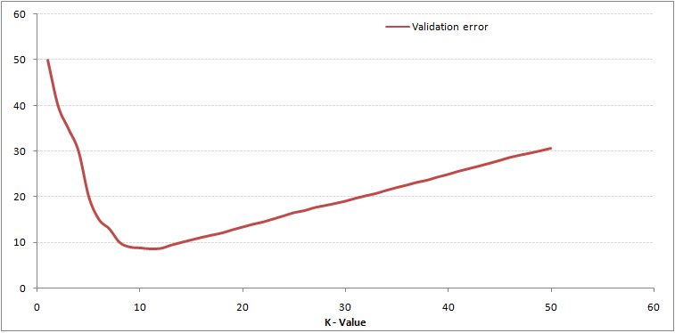
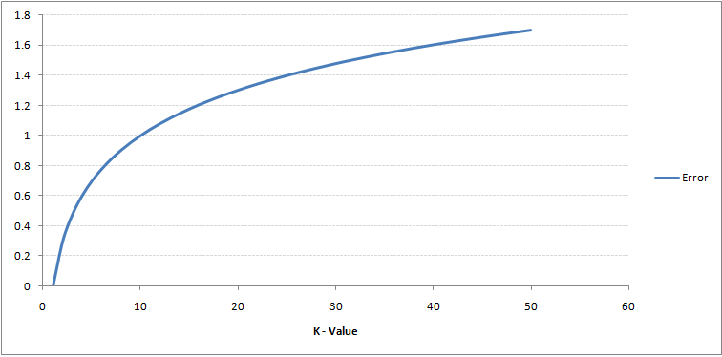


Impact of K

Slide 13
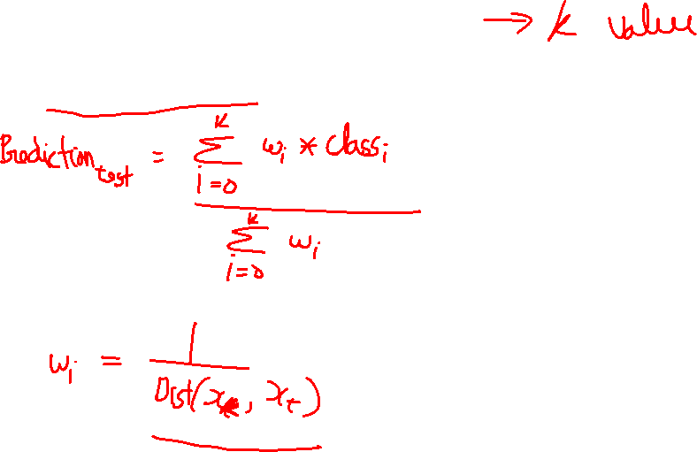
Distance weighted KNN
Take large value of K

Slide 14
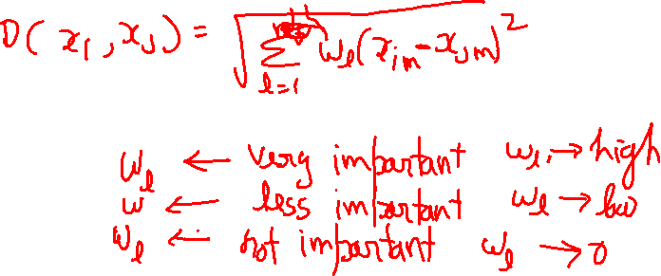
Weighted distance function

